Slide 1

MOBILE APPLICATION DEVELOPMENT- FLYING PLATES
PavanKumarReddy Sama- 50559251

Slide 2

Introduction
With the increasing popularity of food delivery in colleges and universities, the traditional telephone order food has become inconvenient to the customers and the food delivery store. The online food ordering system provides convenience for the customers. It overcomes the disadvantage of the traditional queuing system.
Therefore, this system enhances the speed and standardization of taking the order from the customer. It provides a better communication platform. The customers need not go to the restaurant by themselves, but they can order the meals through Android mobiles anywhere.

Slide 3
Introduction
Flying Plates is a Mobile android application to provide online food ordering and delivery to the customers. Customer must provide a valid username and password to login into his accounts. Upon successful login, the customer is redirected to the Home screen where he can choose different types of foods like American, Indian, Mexican, Chinese, Italian and Japanese Foods on main menu, View/Update profile information, Signout.
Each screen uses a java class to handle the programming and business logic. Java classes include all necessary conditions to check the validity of user login, cart amount etc.

Slide 4
Main Idea
The key idea is to implement an android project using Java programming language with the help of backend database (firebase)where entire data is stored in centralized database.
To overcomes the disadvantage of the traditional queuing system, I had decided to develop an food order application which would be easy for users to order the food through online. The customers need not go to the restaurant by themselves, but they can order the meals through Android mobiles anywhere.
The implementation of database is through Json file using Firebase database and authentication, Storage is also done through firebase.
The project implementation is done through Android Studio with java as a programming language.

Slide 5
Requirements For Implementation
Android Studio
Firebase
Json file support software like Sublime
Java Programming Knowledge
Database
Android Phone or Tablet

Slide 6
WORKING

Slide 7
HOW It WORKS?
When user logins successfully into application, user will be redirected to home screen where he can choose different types of foods like American, Indian, Mexican, Chinese, Italian and Japanese Foods. In Navigation drawer, user can choose Home, Profile and Signout.
Users have option to choose the type of foods. User will get details of foods like name, type and price. Users can select the food from the menu list, add the item to cart and can get processed further. User can update the cart by increasing/decreasing the quantity and also delete the item in cart page. User needs to enter the shipping details and can enter promocode in the promotion page. Use will have online payment option and needs to enter the card details. User will get confirmation screen upon successful payment. User will get notification of the order upon successful order.

Slide 8
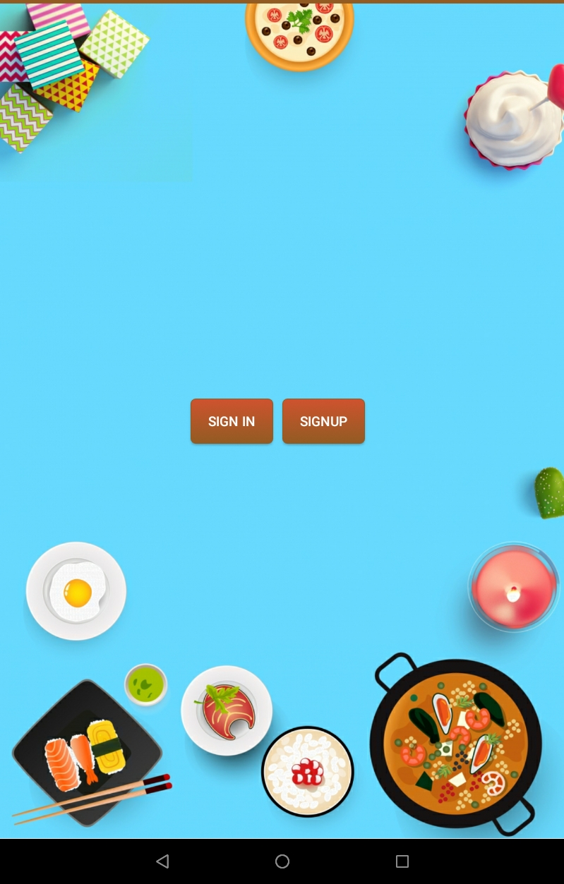
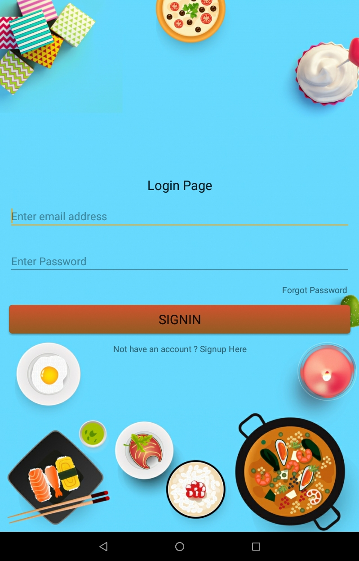

WELCOME & LOGIN PAGE SCREEN
WELCOME SCREEN
LOGIN PAGE
LOGIN PAGE WITH SUCCESFUL CREDENTIALS

Slide 9


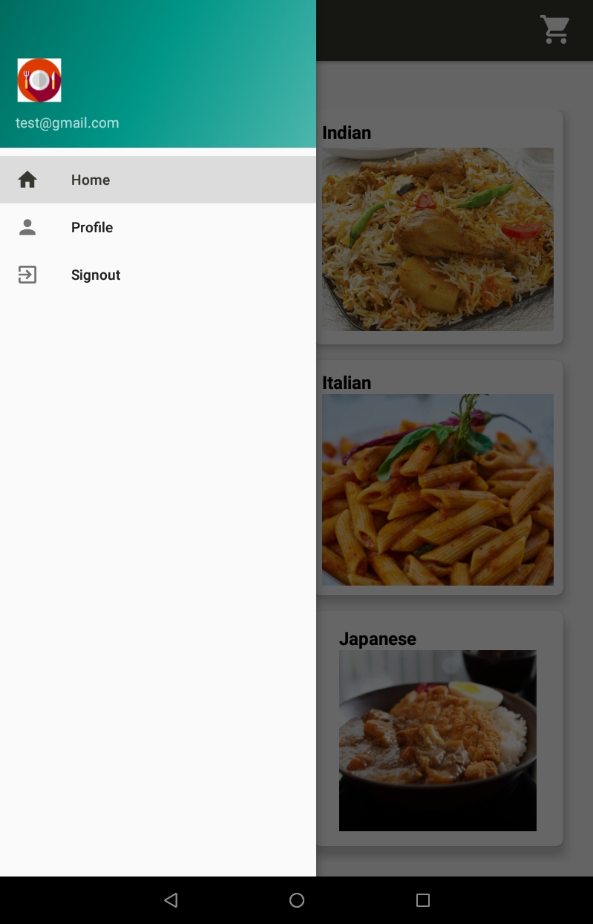
Registration & Reset Password, Home Activity
REGISTRATION SCREEN
RESET PASSWORD
NAVIGATION DRAWER

Slide 10
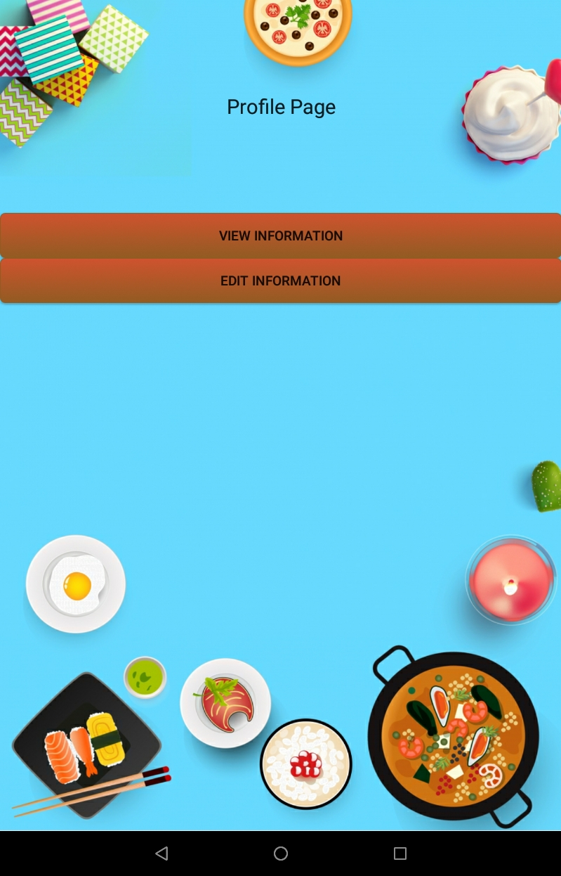
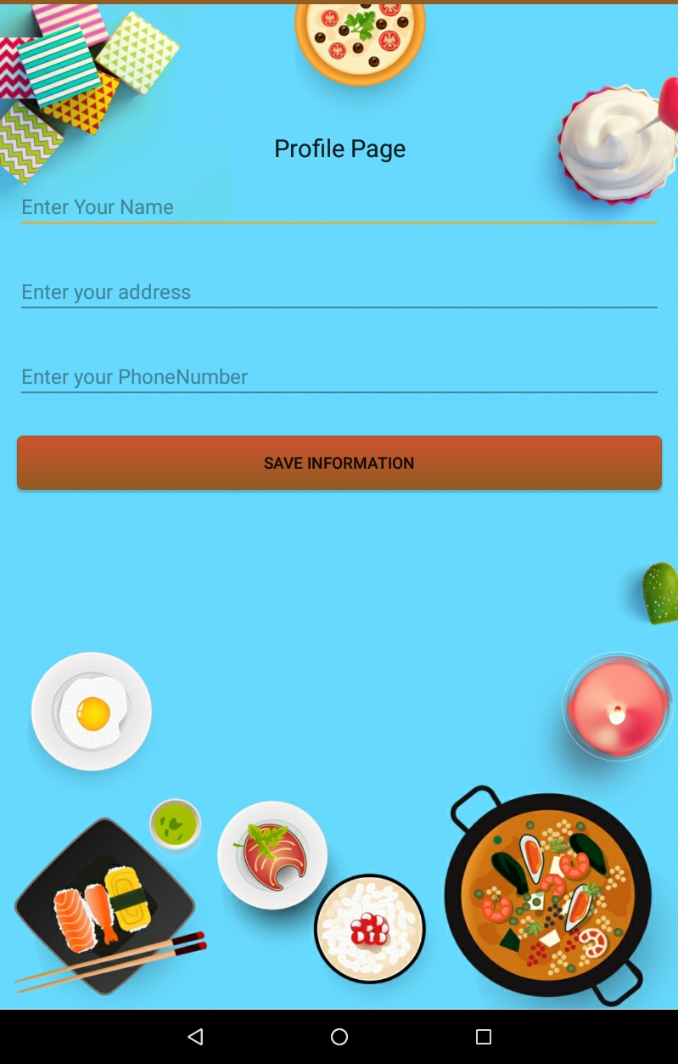
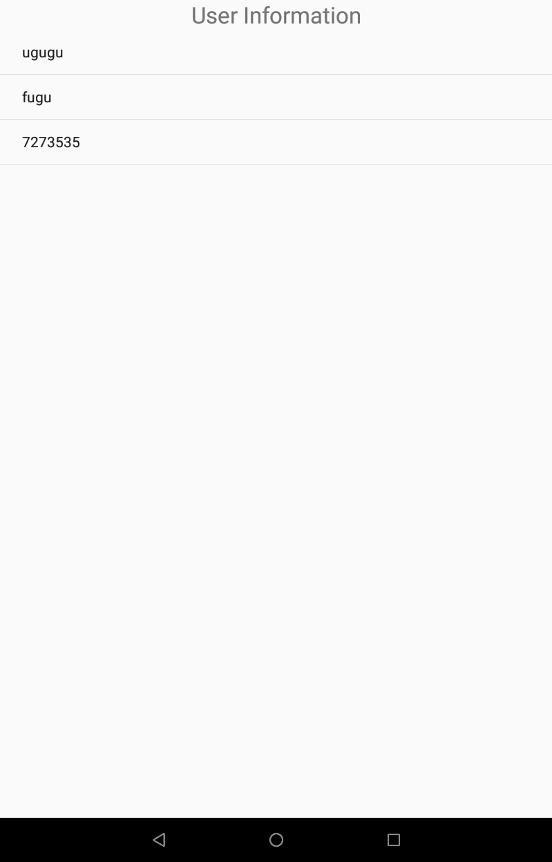
Profile Screen
PROFILE SCREEN
EDIT PROFILE
VIEW PROFILE

Slide 11
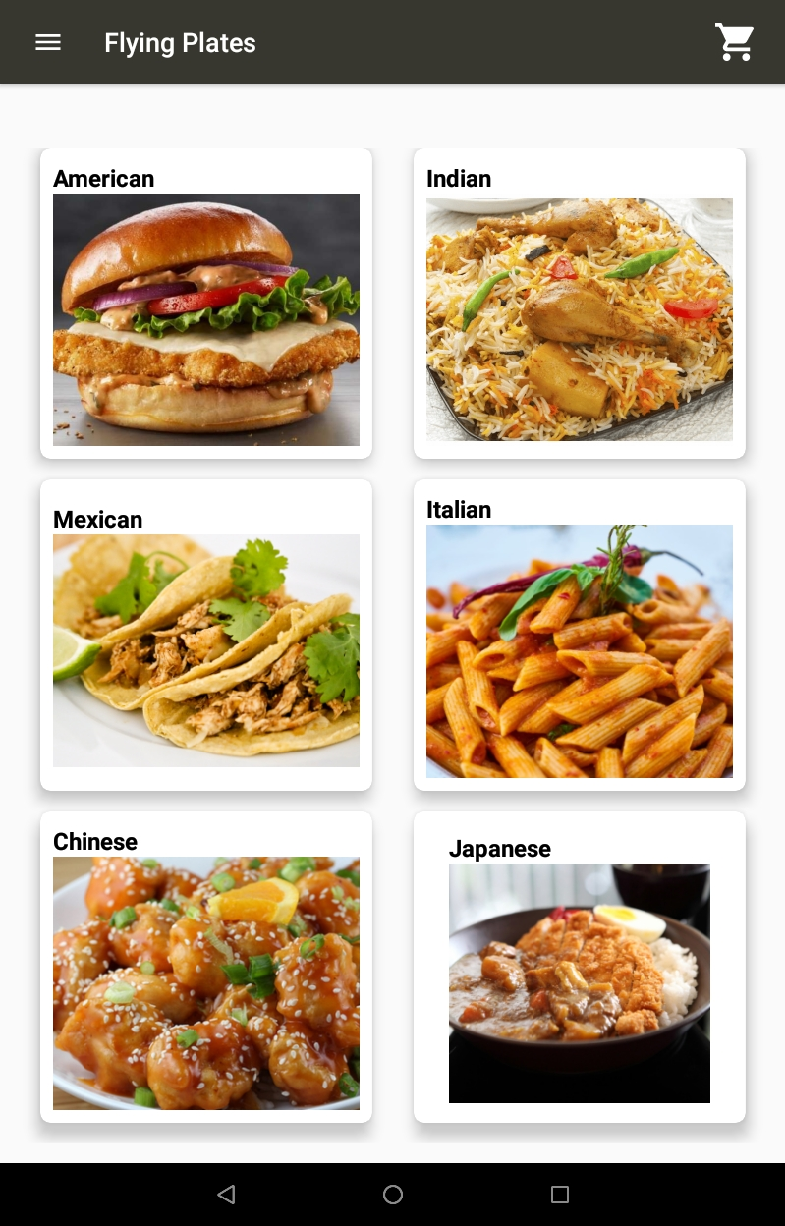
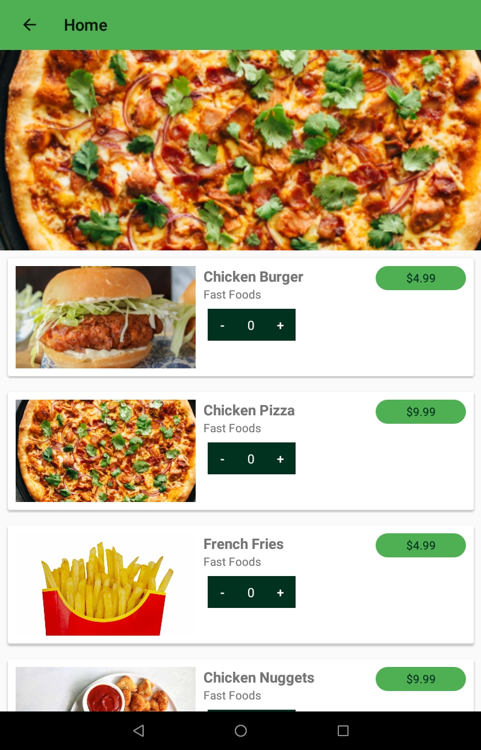
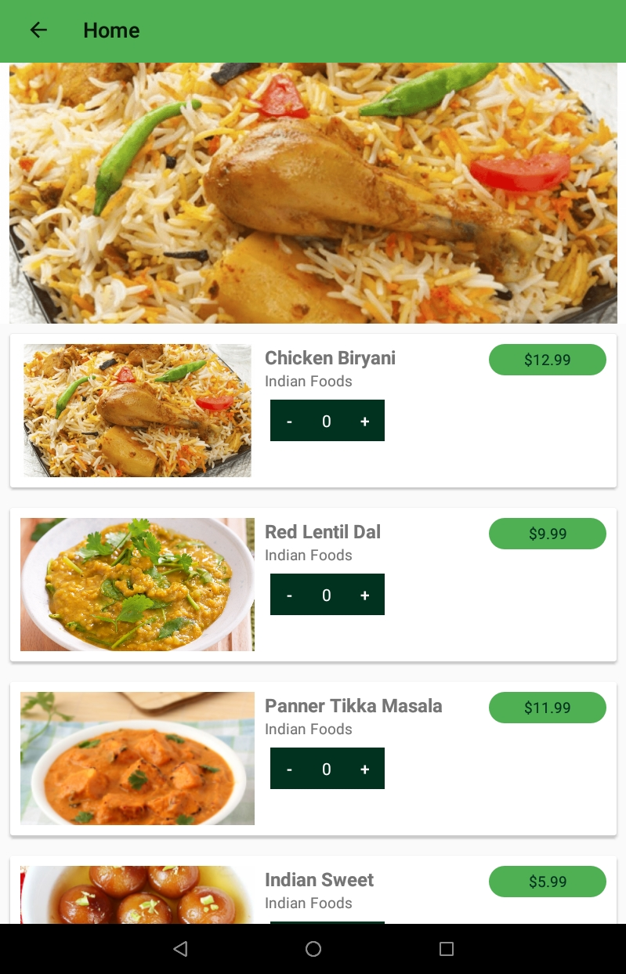
Home & Foods Screen
HOME SCREEN
AMERICAN FOODS
INDIAN FOODS

Slide 12
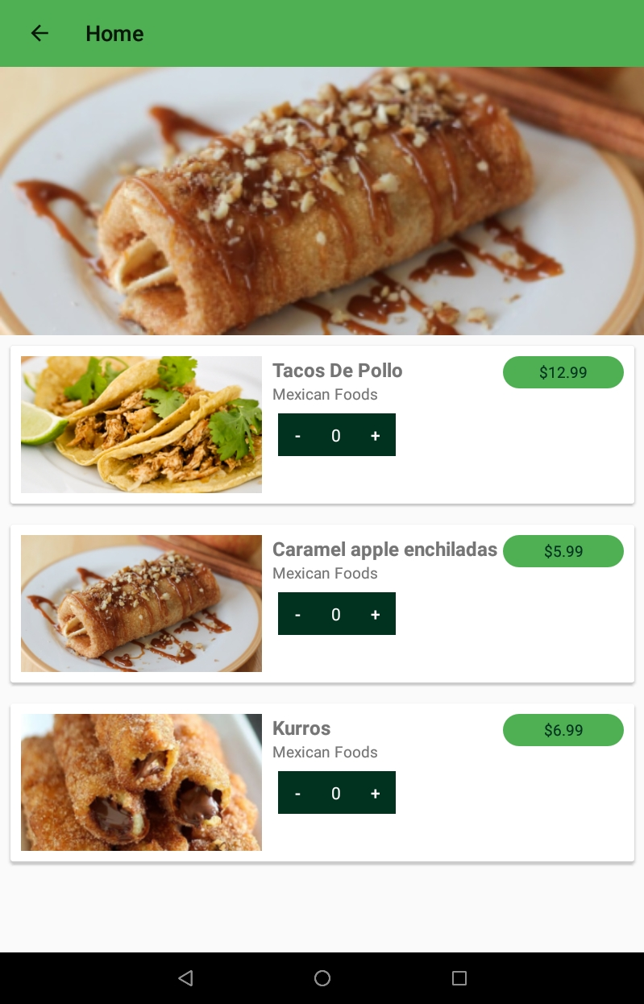
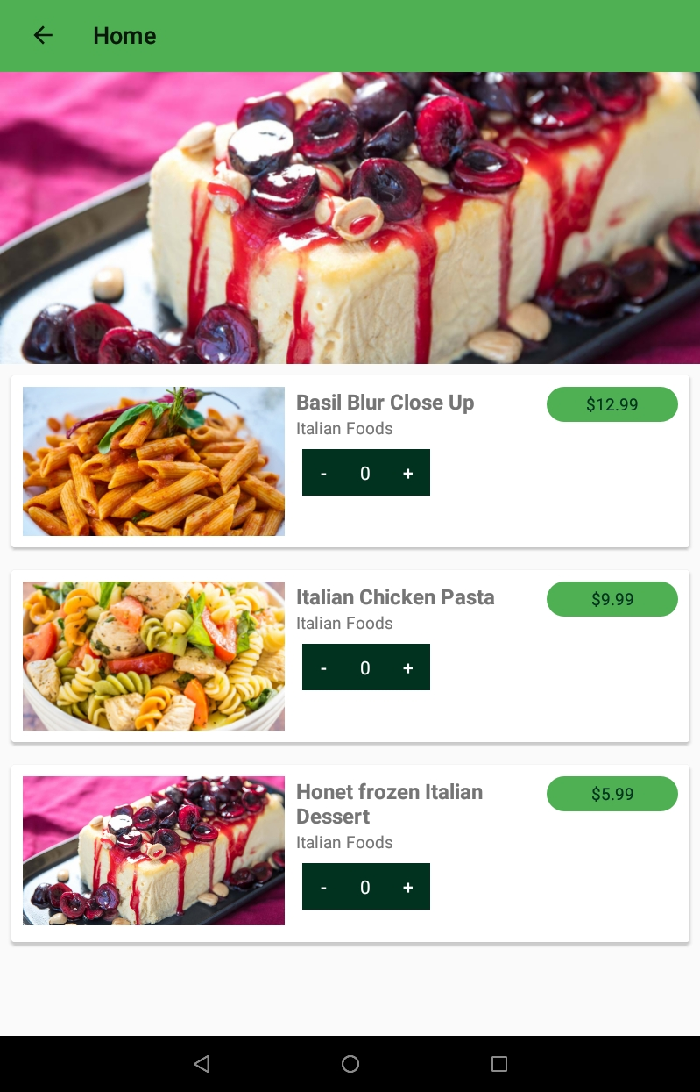
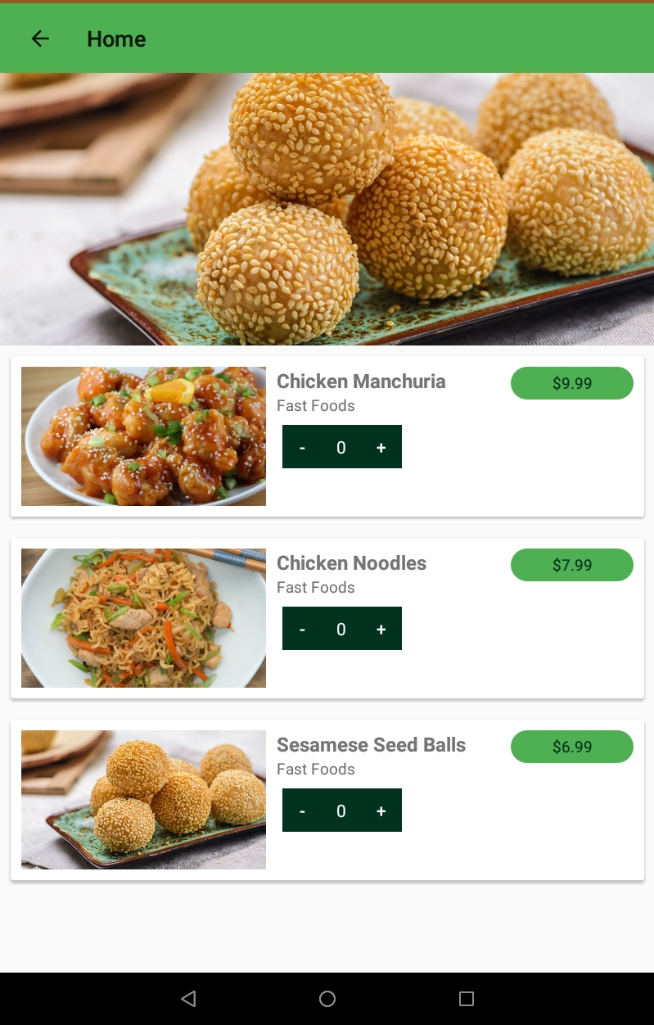
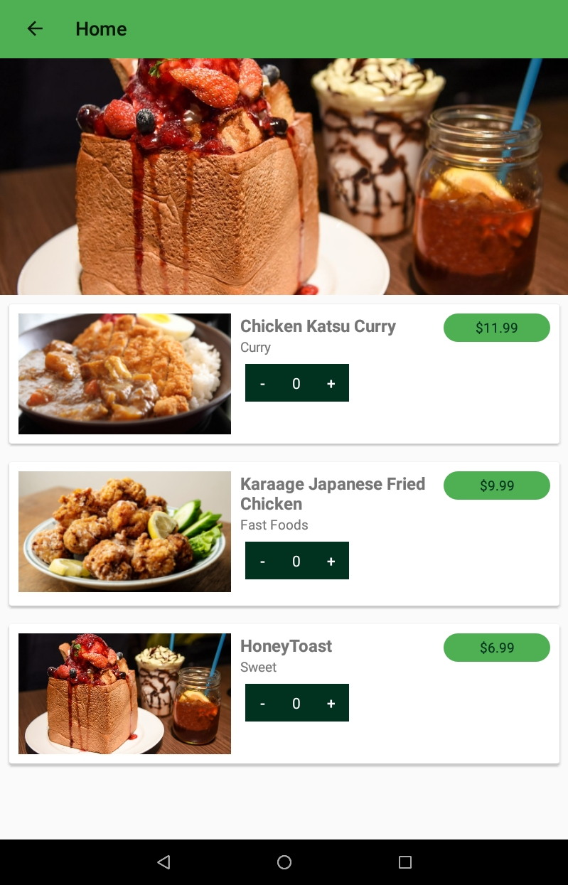
Different types of Foods Screen
ITALIAN FOODS
MEXICAN FOODS
CHINESE FOODS
JAPANESE FOODS

Slide 13
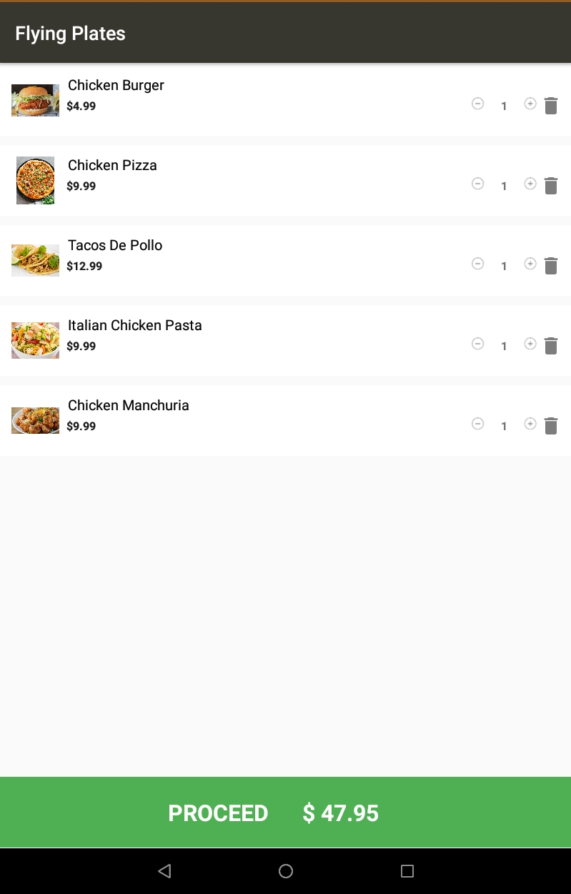
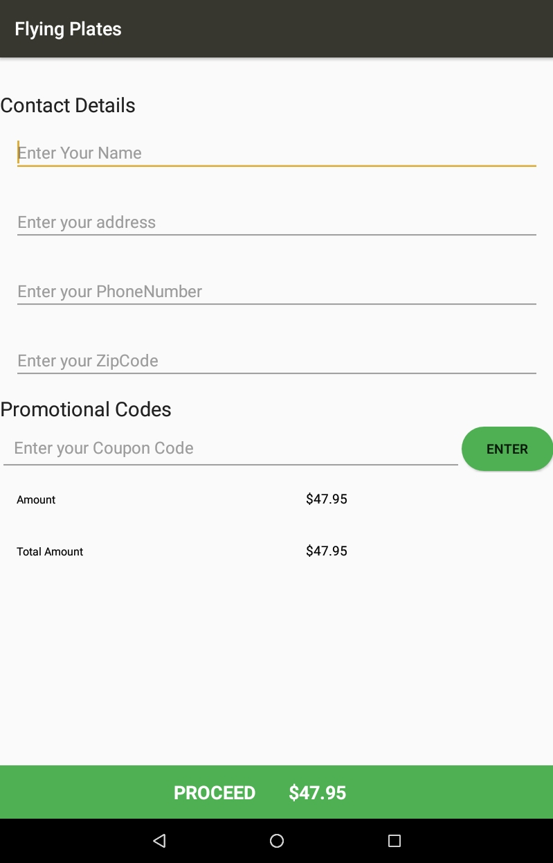
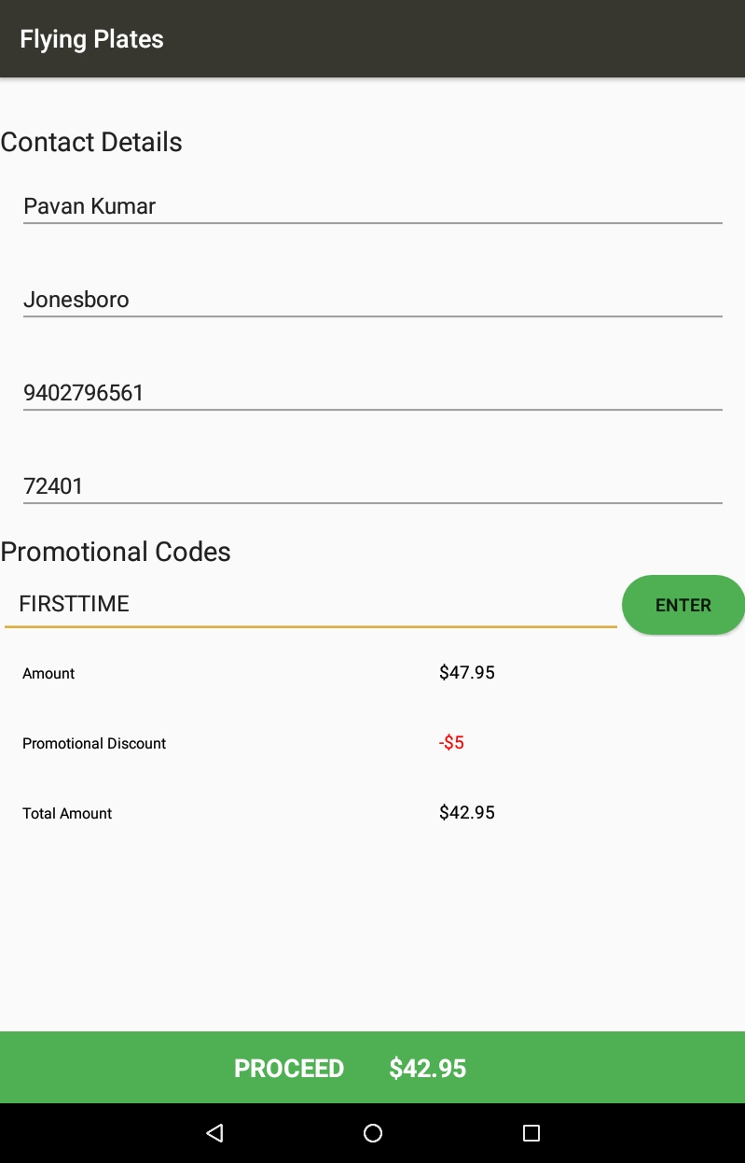
Cart & Shipping Information Screen
Cart Information
Shipping Information
Promotional Code

Slide 14
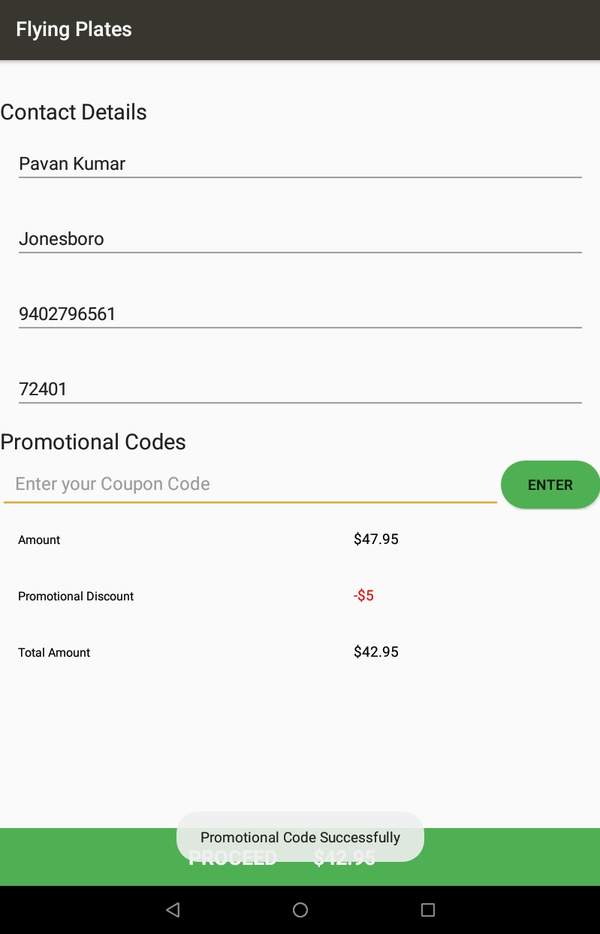
Promotional Code Screen
After user enters the shipping details. User can enter the promocode “FIRSTTIME”. User will get the promotional discount $5.
In order for the user to successfully apply the promocode, user needs to make a minimum cart amount of15$.
Promocode is valid only for the first time.
Promocode Success Page

Slide 15
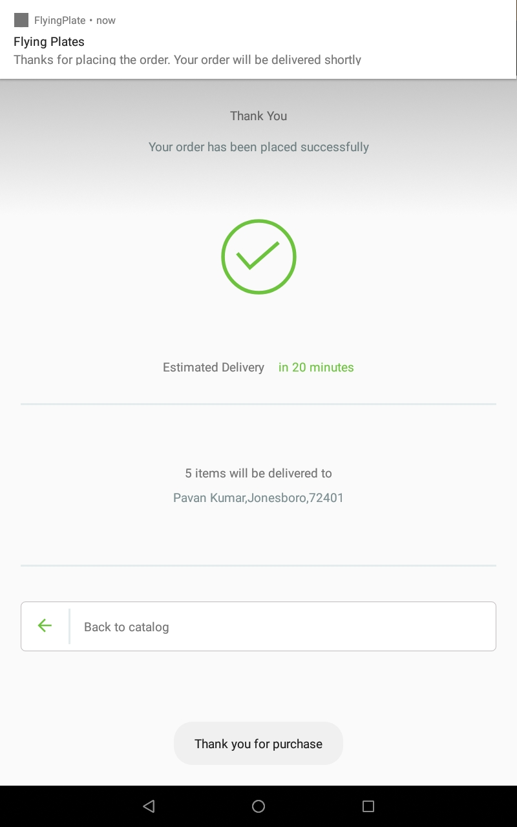
Order Confirmation Screen & Notification Screen
If user successfully places the order with a valid payment details , then user will get a notification saying that the order is confirmed and will be delivered shortly
Order Confirmation Screen

Slide 16
Application Working
When user opens a welcome screen is displayed , the user must select Sign up/ Sign in that shows on the screen.
Then the user is required to enter his Credentials for authentication , the entered credentials are checked with the firebase database. If the user enters wrong credentials, he cannot access the application.
Once the authentication is success , “Home Screen ” is displayed then user can select different types of foods.
If user forgets the password, then user can click on “Reset password” to recover the account.

Slide 17
Project Features
Google firebase mobile authentication for user sign-in/ signup.
Material Navigation Drawer and Fragments for Home,Orders,Profile and Signout.
Different types of food menu using GridLayout.
Different types of food under a menu item using material ui.
Details about food and add to Cart option.
Promtional page for redeeming coupons.
Payment page with braintree payment integration.
Used google firebase database to perform crud operations with data related to cart information, payment details and orders.
Place order and store the order details in Firebase.
User will get notification after placing the order successfully
Display order details

Slide 18

Development Tools &Technologies
Java
XML
Firebase Authentication
Firebase Database
Material design
Navigation-Drawer
Braintree
Database
Firebase

Slide 19
App-ACTIVITIES
Activities that a user can Perform
User Registration
Reset Password
Viewing Main Activity
Promotional Code Activity
Updating Profile Information
SignOut

Slide 20
Using Library
MaterialEditText : For responsive EditText design
Elegant Number Button : Implement a number counter with increment and decrement buttons.
TextDrawable : This light-weight library provides images with letter/text like the Gmail app.

Slide 21
Database

Slide 22
Firebase
It is a platform for building Android ,iOS and web apps .It provides services like
Authentication
Hosting
Messaging
Cloud Storage
Real Time database

Slide 23
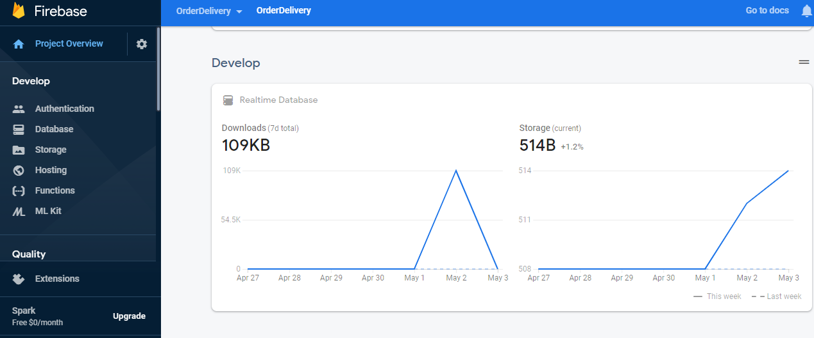
Firebase

Slide 24
Why Firebase
Creation of application can be done without any backend server.
It has libraries for JAVA, JavaScript, Android and iOS.
It automatically saves data to backend and can be used in any instances of application through synchronization.
It uses Json so it is faster than any other backend web services.
Without Server-side programming ,applications can be created
Only write front end code
Secured and Data monitoring is easy

Slide 25
Firebase-Database(Real-Time)
Whatever the data is entered in Android Phone it is added in the Realtime database therefore the effective changes can be seen in the Json file.
There is also a provision to add anything in Json file directly through Firebase .
The Added data through Firebase can be retrieved from android phone by refreshing the app.

Slide 26
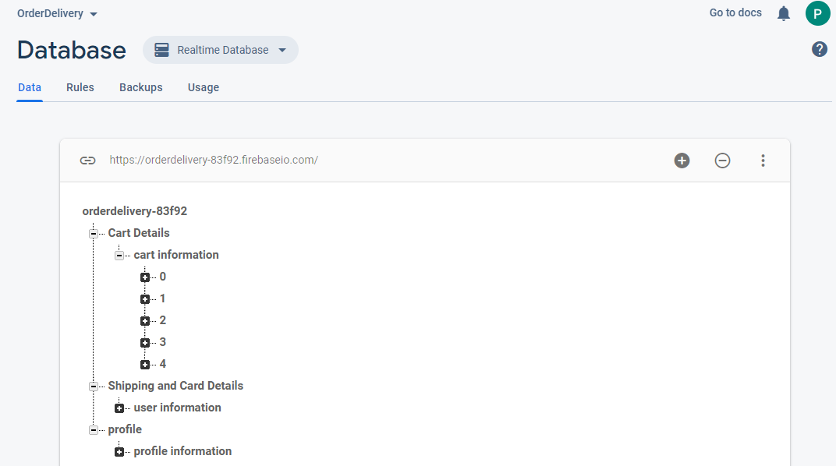
Firebase-Database(Real-Time)

Slide 27
Firebase-Authentication
In the Firebase Authentication when ever a user enters the Email and password in the user-interface it goes to the backend server which is firebase authentication and checks whether it is an authorized user or not.
If the Provided details are wrong the user cannot log into system and it shows the error message as “Invalid id or Password” in the Login page .

Slide 28
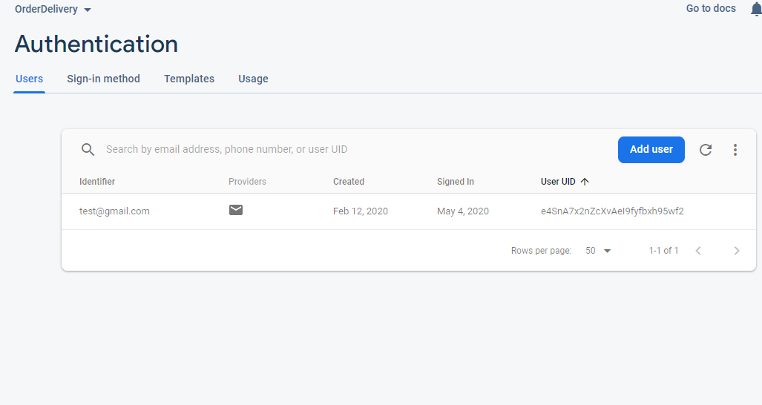
Firebase-Authentication
USERS

Slide 29
Security Features
Anonymous user cannot login without providing required Details or Valid information.
Regular Monitoring is done through firebase and reports are send through Quality service.

Slide 30
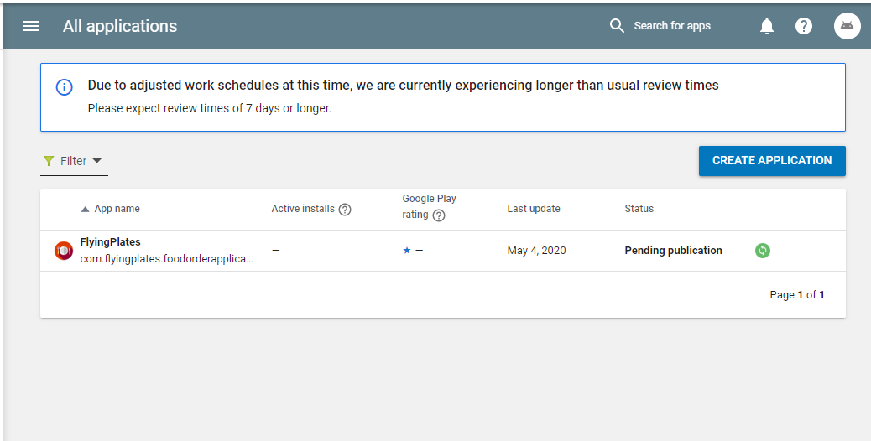
APK File and Play console Status
https://play.google.com/apps/publish/?account=9075340798884485048#AppListPlace

Slide 31
Thank You

